Slide 1

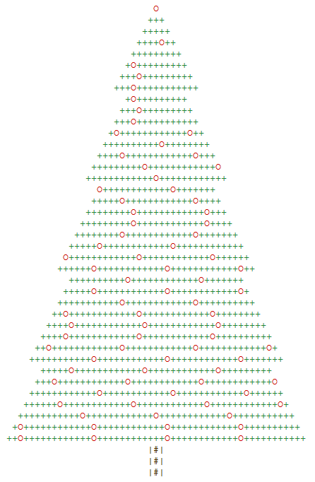
@RLadiesAU
Christmas Party!!
11th December 2017

Slide 2

Hello!
I am Santa Claus
I am here because I love cookies and I heard the R-Ladies are big into baking! Also I know how to plot a Christmas tree in R. Merry Christmas, happy holidays and stay safe!
@OfficalSanta

Slide 3
Christmas Party: Timeline
Total party time
Fill out crossword
R expertise
Hangman
Christmas plot
Presentation of plots
Lights Out
1st prize: Cinema tickets for the whole group

Slide 4


Calculate the group’s R expertise!
1
2
3
4
5
6
7
8
9

Slide 5
Hangman

Slide 6

Ugly Plot: Christmas edition
Find the datasets love_actually_adj and love_actually_appearance in the R package fivethirtyeight. Remember to use function data()!
Make the ugly (Christmas inspired) plot
After 30 minutes each team presents their plot.
Every team can assign 10 and 5 points to their favourite plot and second favourite plot respectively! (You cannot vote for your own team.)

Slide 7
Lights Out

Slide 8
Raffle Time: Your time to shine
Check your raffle ticket
We will randomly draw raffle stumps
If your ticket is selected come to the stage and introduce yourself and tell us about:
Why you use R
Your favourite R package
And the function in R that you do not understand or took you a long time to understand
Everyone applauds, you get chocolate

Slide 9
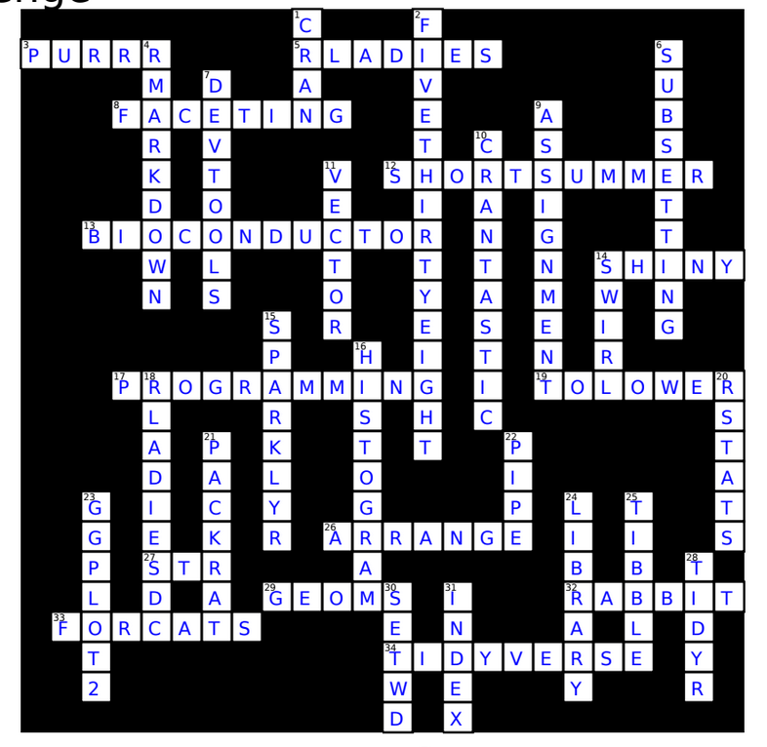
Solutions to the crossword

Slide 10
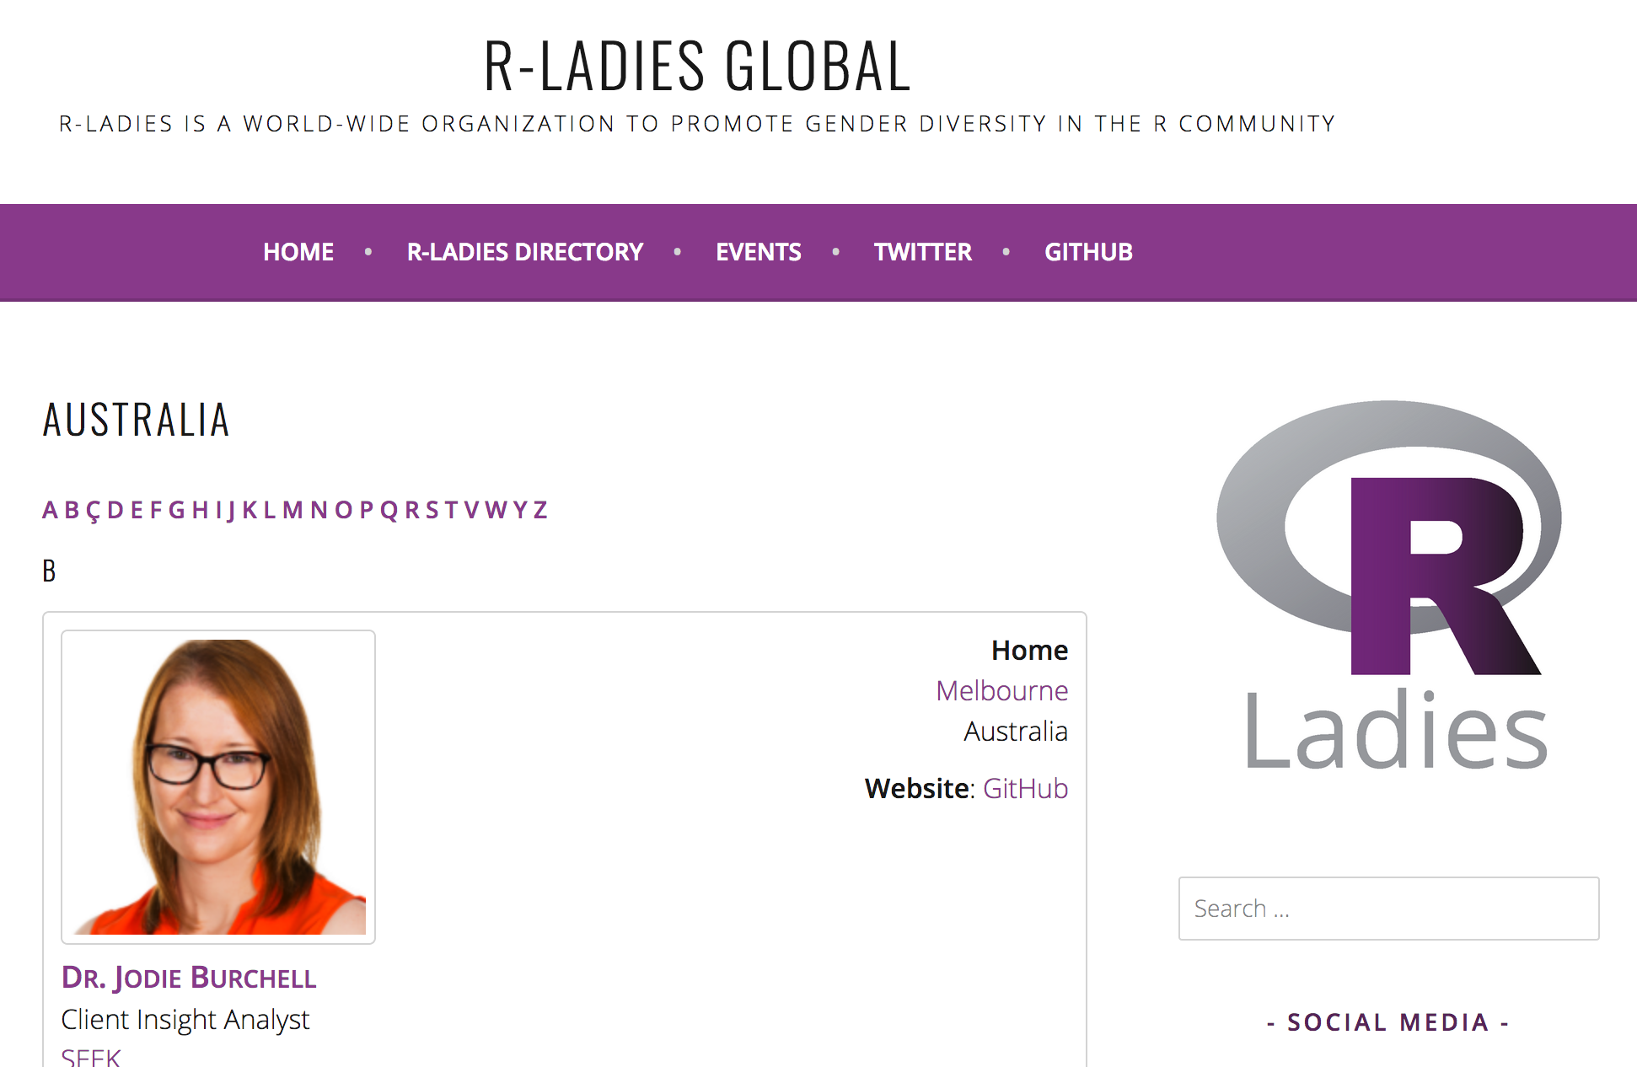
R-Ladies Global Profile
https://rladies.org/australia-rladies/

Slide 11

Biannual Survey

Slide 12

2018: Your year to give a talk?

Slide 13












A big thank...
To our amazing and faithful sponsors
R-Ladies Logo Designer
Matt Ritchie
Roberto Bonelli

Slide 14
Happy holidays, a happy new year and stay safe!
We will see you
in 2018.

